Slide 1
See quiz on humanaiclass.org
Explaining Algorithms: A day with some answers

Slide 2
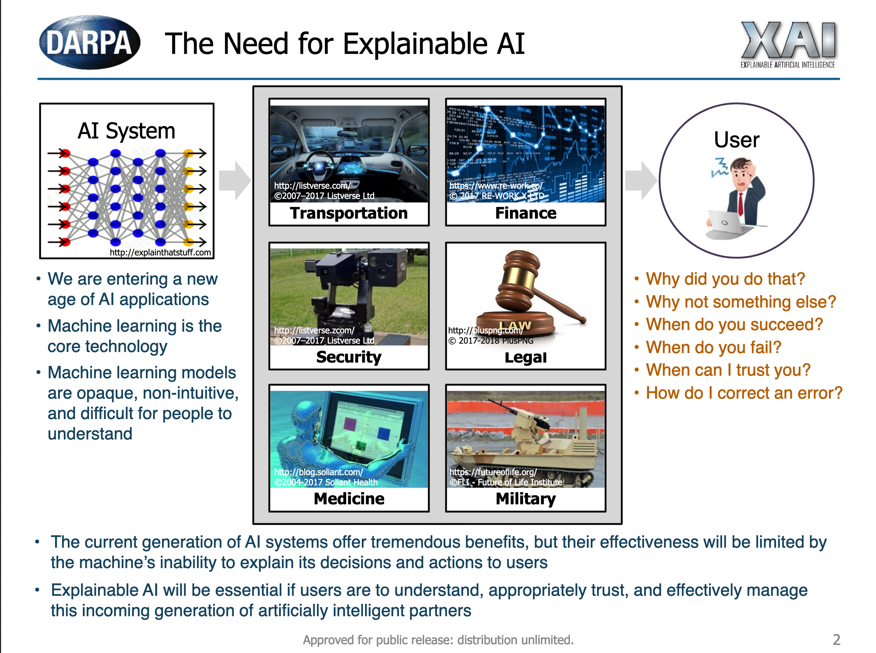
Notes:
https://www.darpa.mil/attachments/XAIProgramUpdate.pdf

Slide 3
Previously…
Different explanations are useful for different questions
Can you just write an explanation without knowing the question?
How do you know what questions people have???
Can we always give people an explanation?

Slide 4


From Week 1: Start at the End …
Ask what the goals are for different stakeholders
What questions they may have
What answers we can give
What to do when you can’t give answers
Training Data (experience)
Machine Learning Algorithm
(task)
New Example
Model
??
Notes:
iteration, and not just on the model, or even the data, although both are important.
We need to iterate to find good problems.

Slide 5
Today...
Are there principled approaches to creating explanations?
Are there trade-offs?
How does explanability intersect with accuracy and fairness?
Meanwhile, look for AI explanations in the products you use.

Slide 6
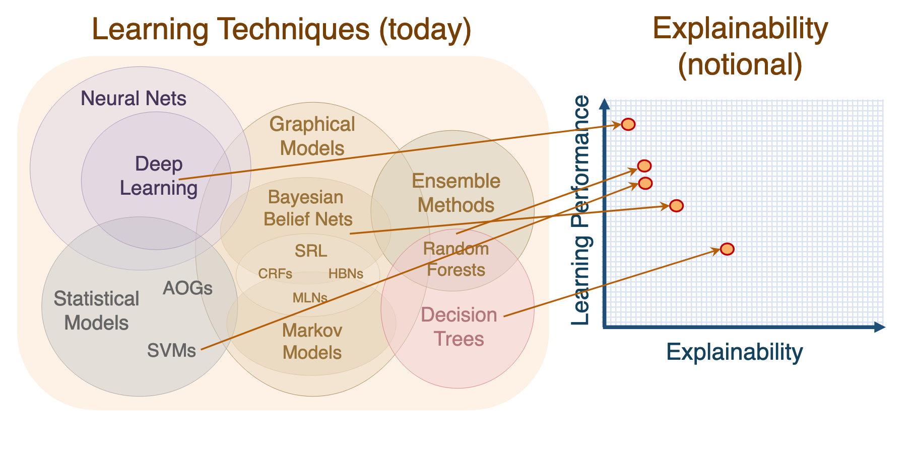
Is this graph accurate?
Notes:
https://www.darpa.mil/attachments/XAIProgramUpdate.pdf

Slide 7
Why bother with explanations/interpretations?
Algorithms can be wrong on examples that human operators get right
Algorithms can be working on outdated data (and have no way to handle “distributional drift”)
Explainable algorithms can further science
People are happier if they feel like they know what’s going on (even if they can’t control it)

Slide 8
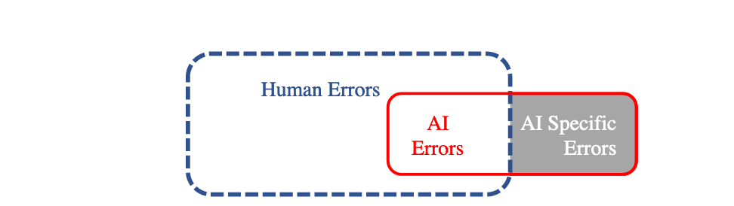

Slide 10
A less performant model may be more accurate if you include human operator.
We care about performance
of AI + human using it

Slide 11
Ways to explain
Questions:
Why did you do that?
Why not something else?
When do you succeed?
When do you fail?
When can I trust you?
How do I correct an error?
Hint: map questions to combinations of answers.
E.g. 1 -> [A+B]
Answers:
Simulation “run through decision process”
Decomposition “here’s the information I used to make decision”
Algorithmic transparency: “Here’s math that proves this algorithm will work, given large enough data”
Simplification: “My model is too complex to represent, but a simplified version is as follows…”
Examples: “Here are five other examples that are similar to this one that I classified the same way”

Slide 12
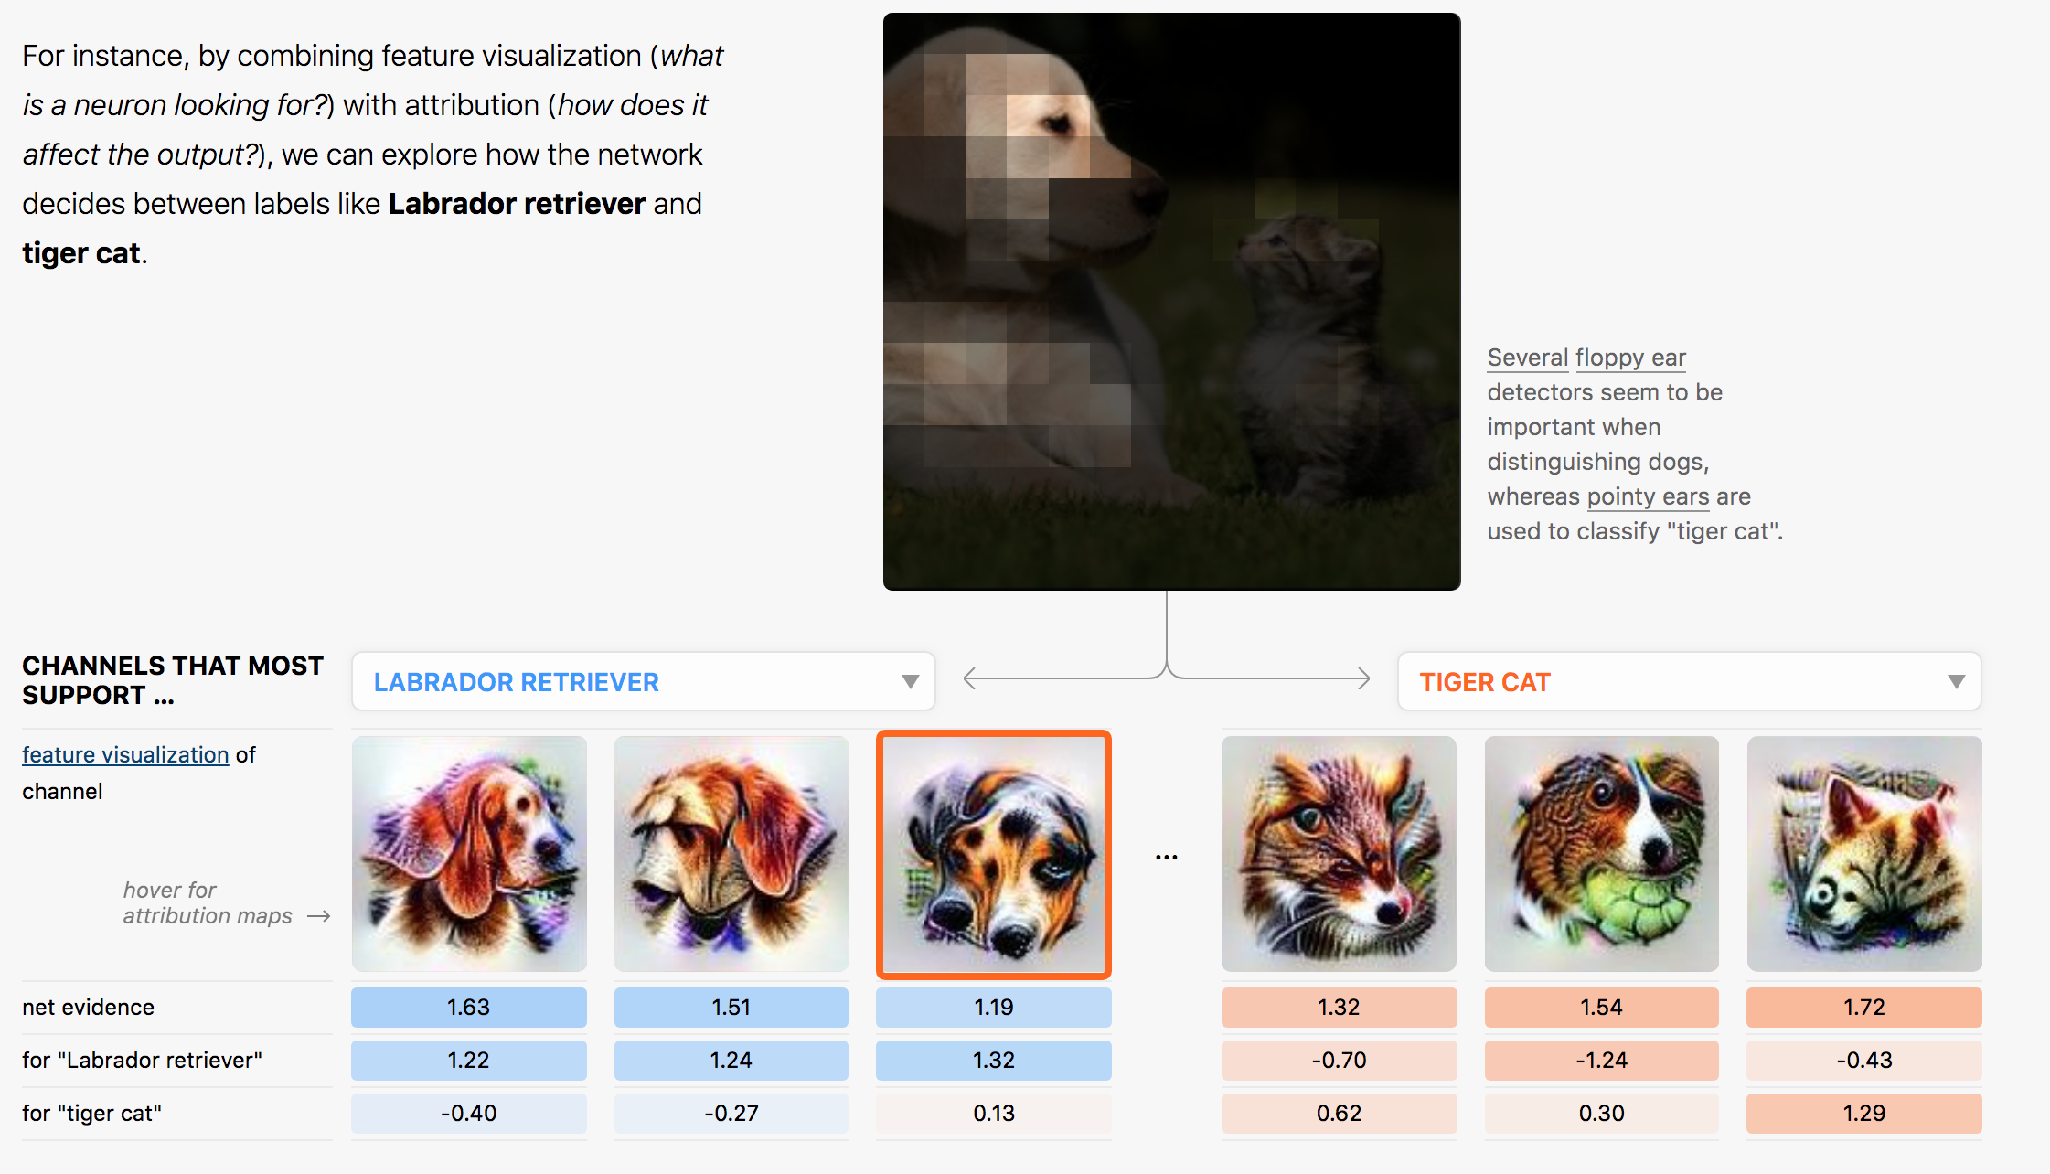
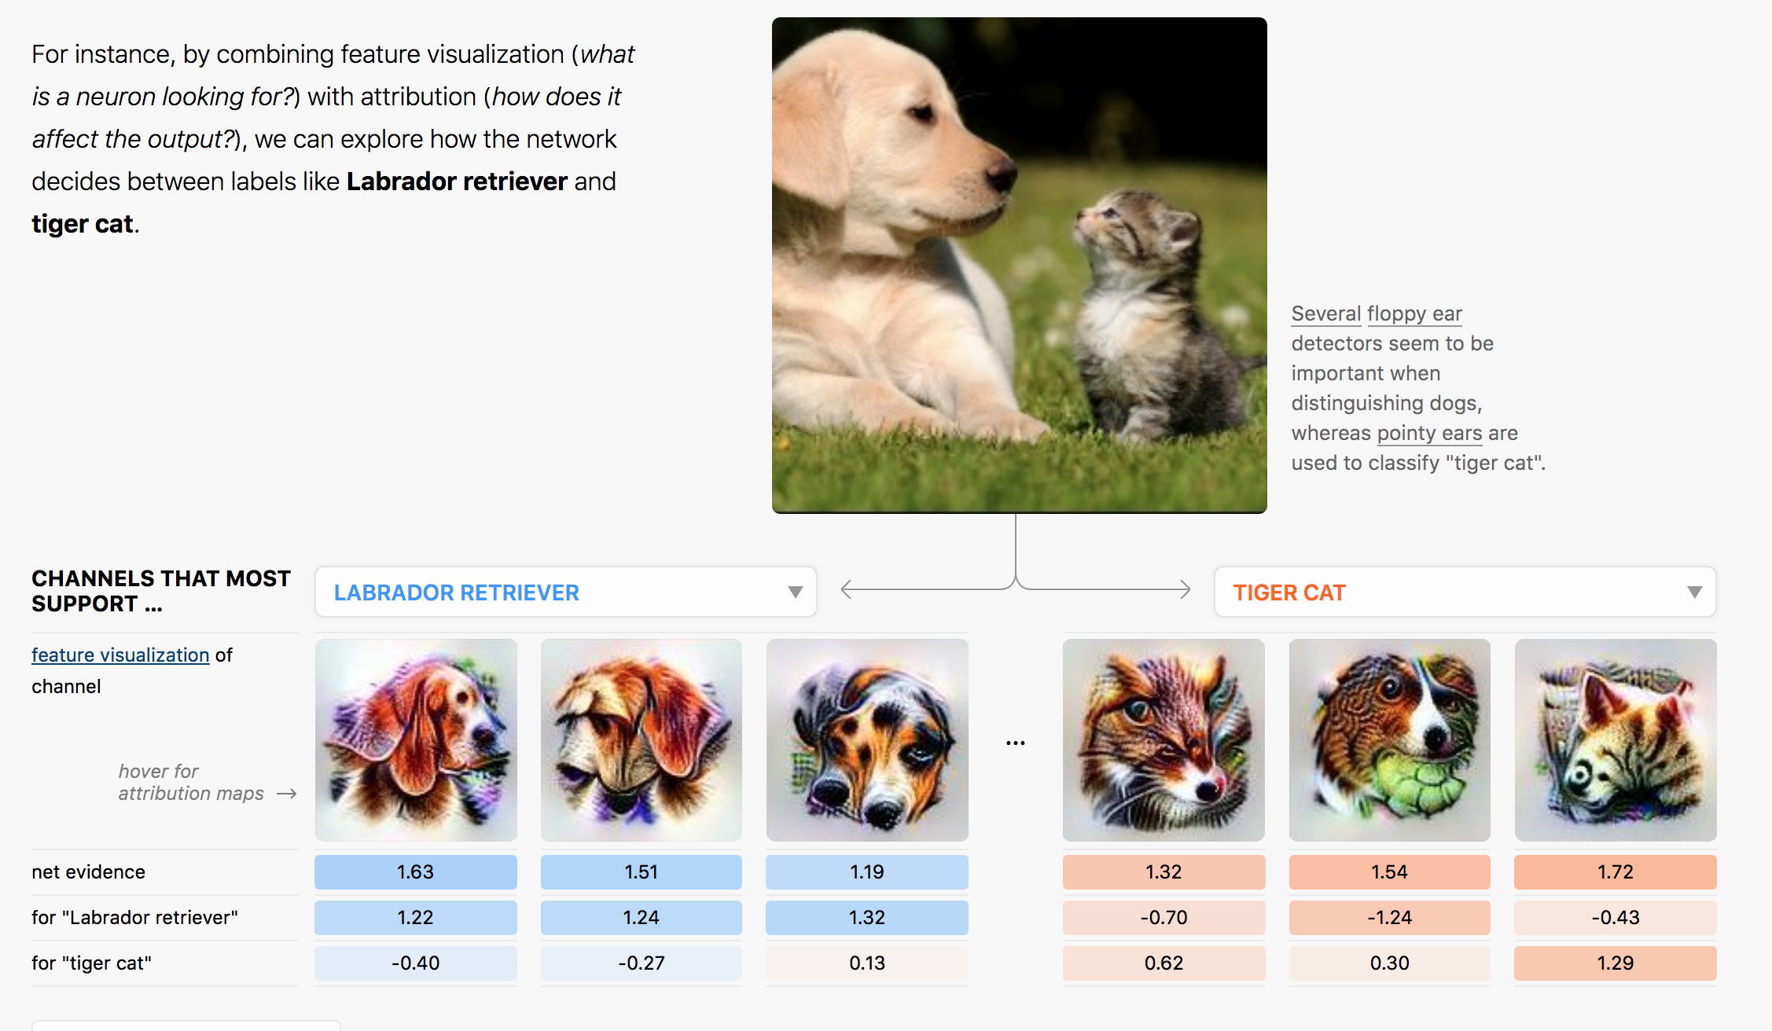
Combining multiple explanation modes
Decomposition
Simulation
Simplification
Notes:
From https://distill.pub/2018/building-blocks/

Slide 13

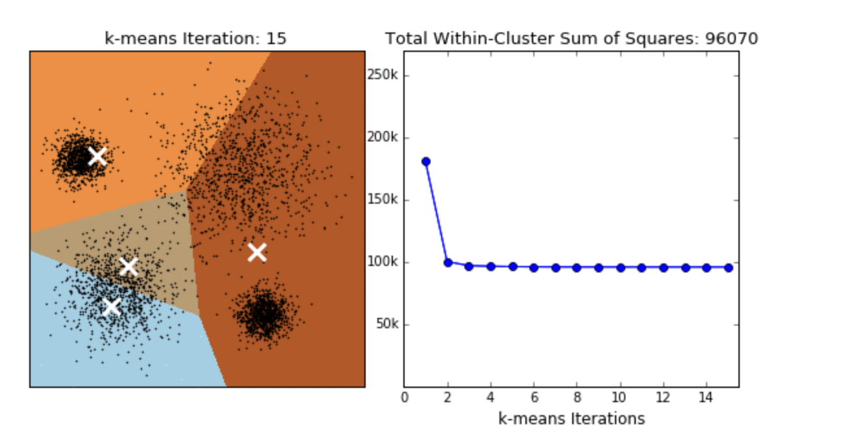
Knowing the underlying algorithm is also useful
How do you correct for bad predictions?

Slide 14
Design with the mind in mind
There seems to be a curious lack of focusing on how humans think in explanation work
When we talk about different explanation methods, ask yourself: how does this improve human cognition?
Answering this question helps you choose the right explanation mode

Slide 15
Design with the mind in mind -1: How people reason
System 1 thinking Fast, automatic, frequent:
determine that an object is at a greater distance than another
complete the phrase "war and ..."
Takes work to override. Brains are lazy.
(if you can’t remember which is System 1 vs. System 2, I can’t either -- I google it every time)
System 2 thinking:
Slow, conscious, infrequent:
“Give me a minute to think about it”
Park in a tight parking spot
Write a note for a project extension
Takes effort. => people are unable to do it if: tired, sleep deprived, task is repetitive, etc.

Slide 16
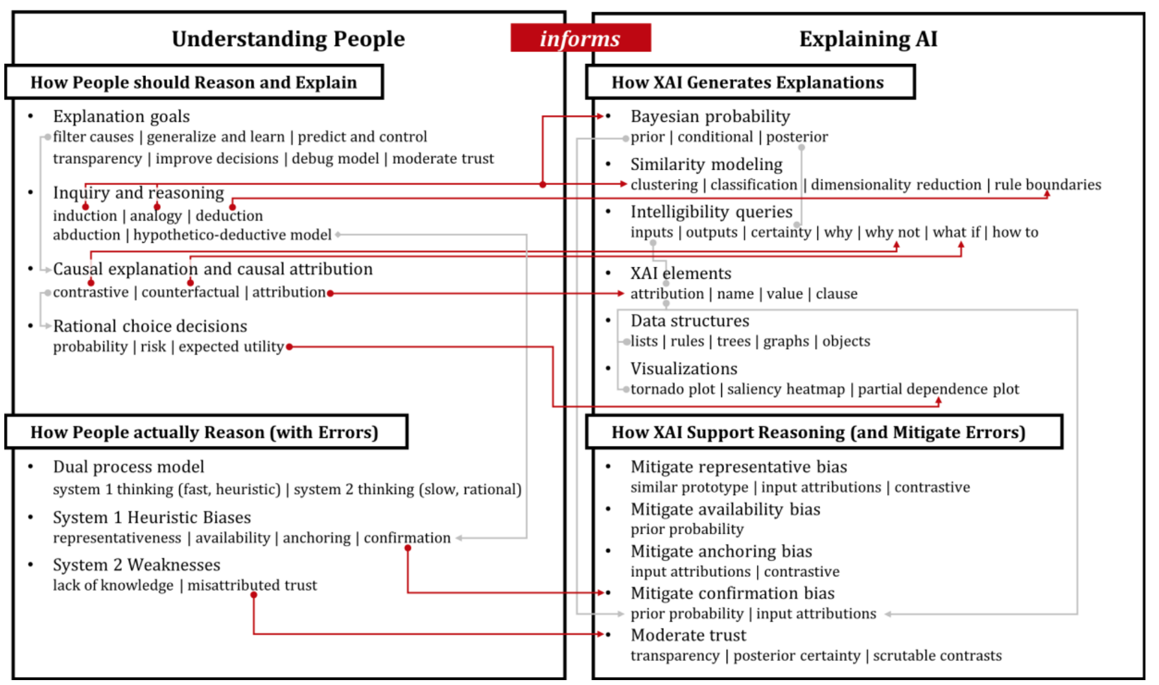
Notes:
http://www.brianlim.net/wordpress/wp-content/uploads/2019/01/chi2019-reasoned-xai-framework.pdf

Slide 17
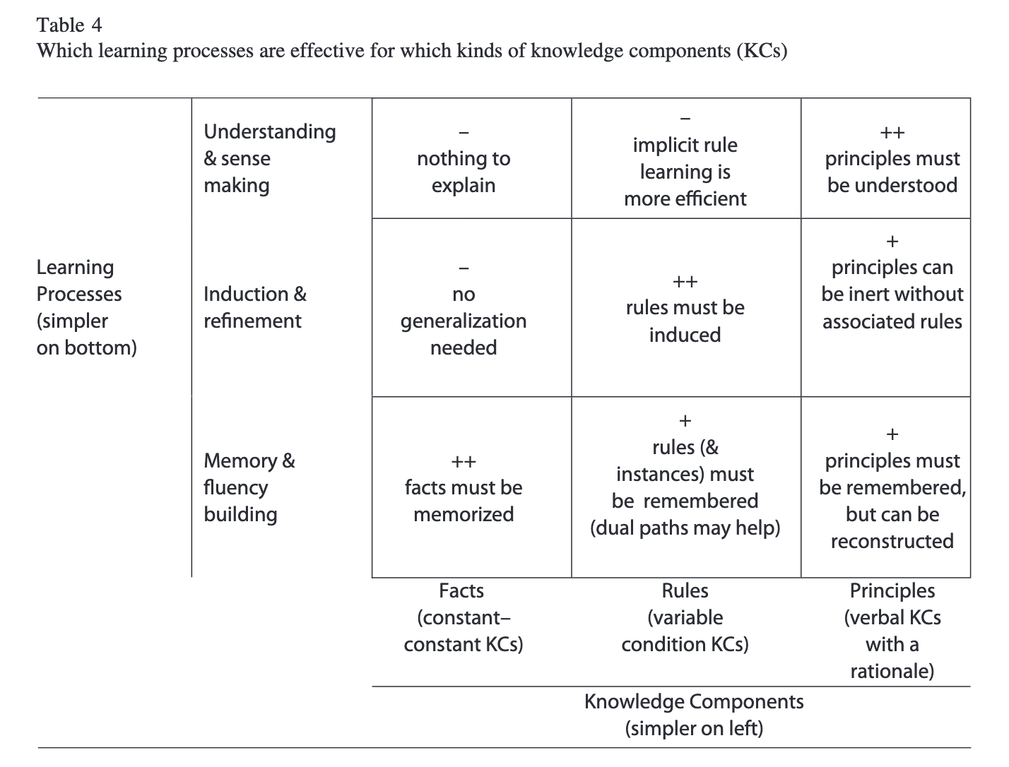
Designing with the mind in mind -2: How people learn
Notes:
From http://pact.cs.cmu.edu/pubs/Koedinger,%20Corbett,%20Perfetti%202012-KLI.pdf

Slide 18
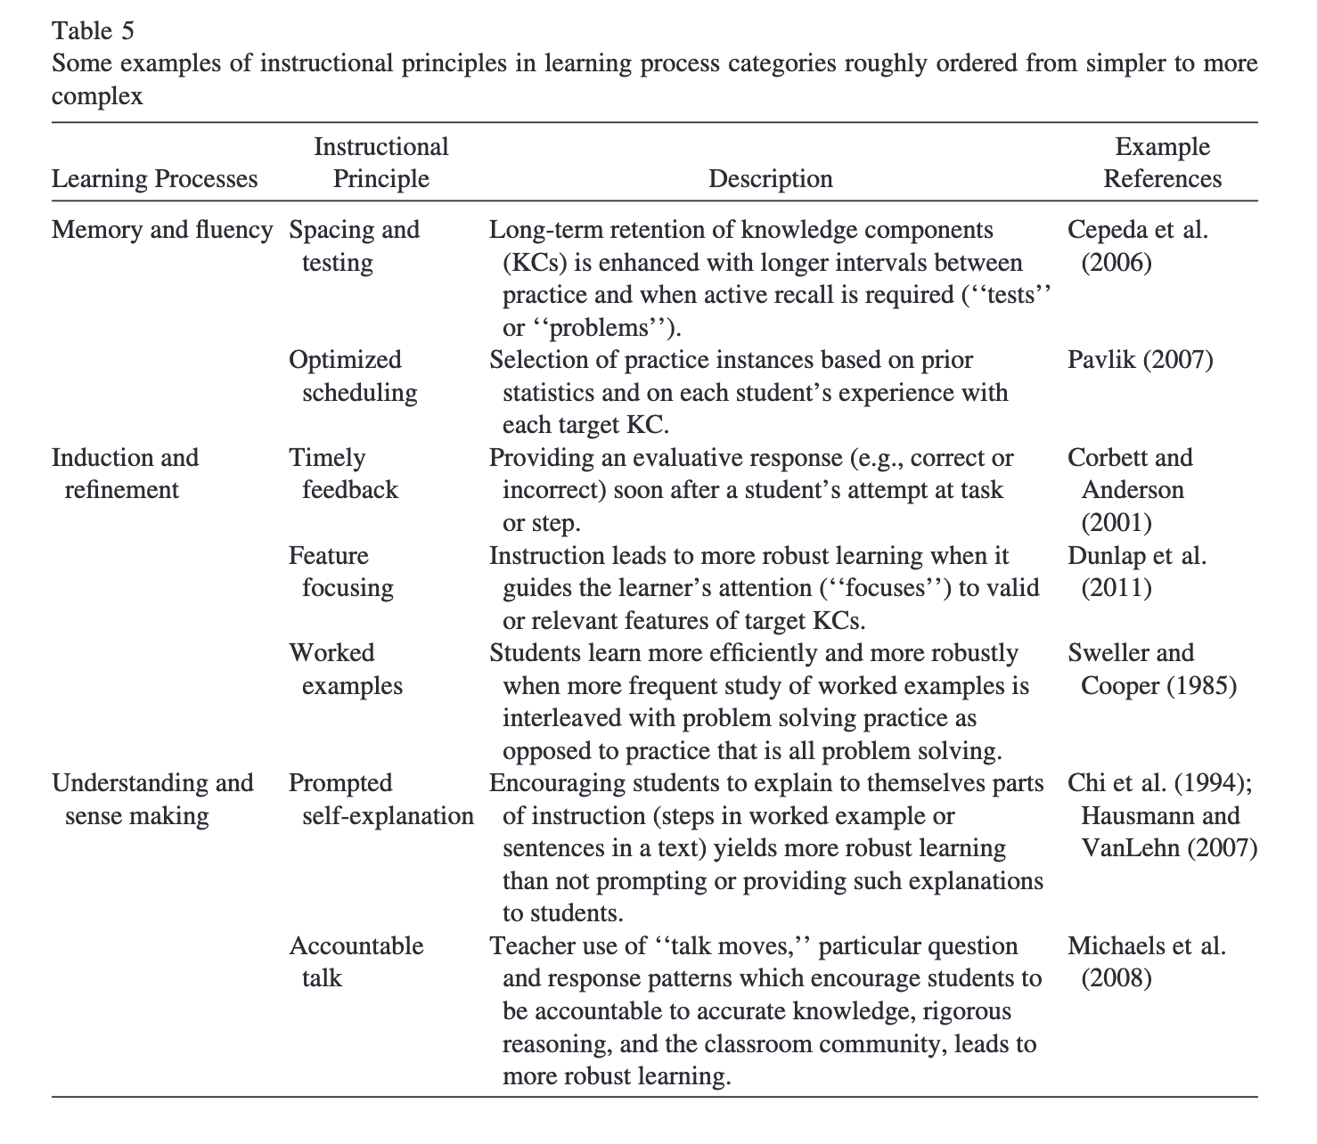
Designing with the mind in mind -2: How people learn
Notes:
From http://pact.cs.cmu.edu/pubs/Koedinger,%20Corbett,%20Perfetti%202012-KLI.pdf

Slide 19


What kind of knowledge is this explanation providing?

Slide 20
What kind of reasoning do we expect post-explanation?

Slide 21


What kind of knowledge is this explanation providing?

Slide 22
What kind of reasoning do we expect post-explanation?

Slide 23
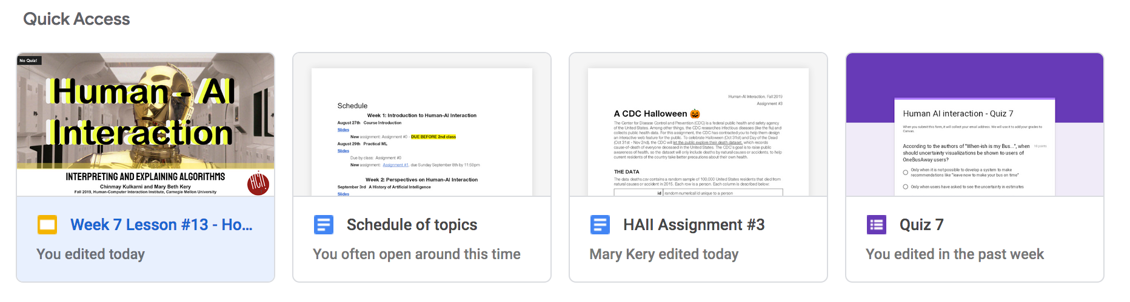
What kind of knowledge is this explanation providing?

Slide 24
What kind of reasoning do we expect post-explanation?

Slide 25

What kind of reasoning do we expect post-explanation?

Slide 26
What kind of knowledge is this explanation providing?

Slide 27
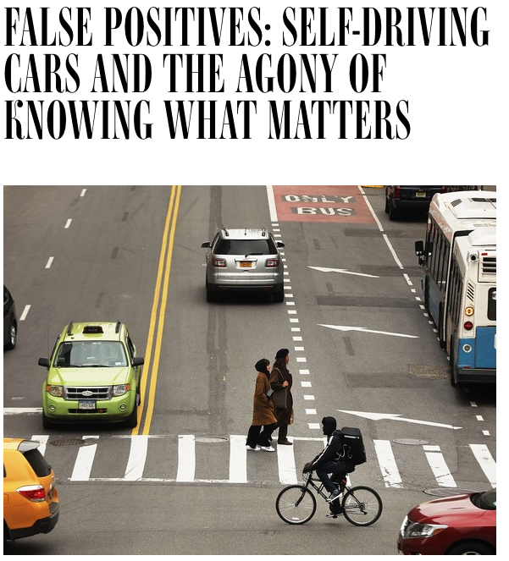
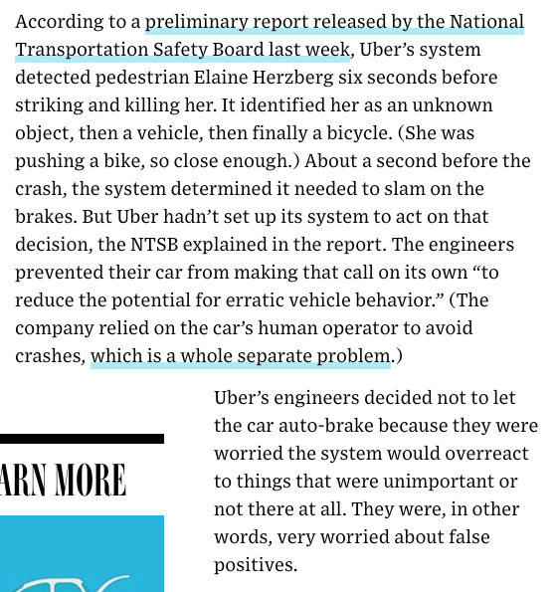
What kind of knowledge would be useful here?
https://www.wired.com/story/self-driving-cars-uber-crash-false-positive-negative/

